Slide 1
Beyond The Seas
Class and ER Diagram
Group 3 (B2)
Presented By:
Azizur Rahman Anik: 1805115
Sanjida Islam Era: 1805116

Slide 2
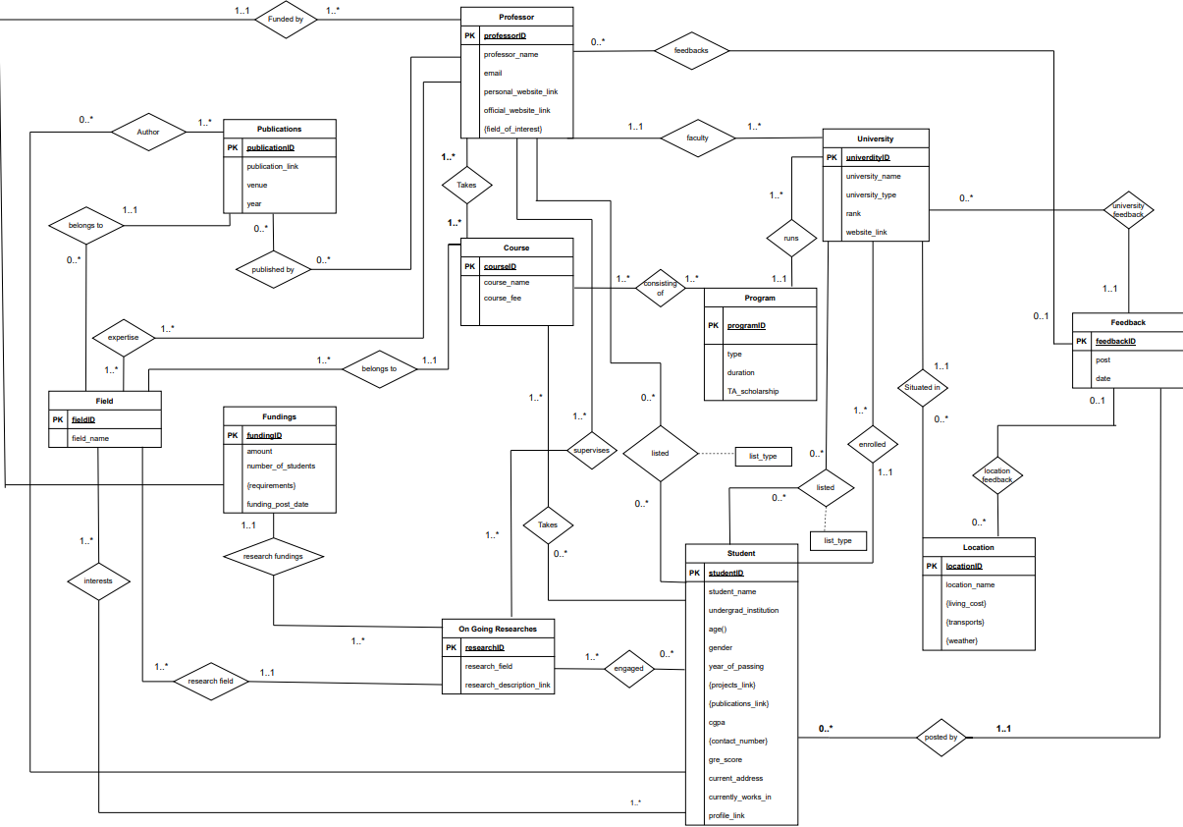
ERD

Slide 3
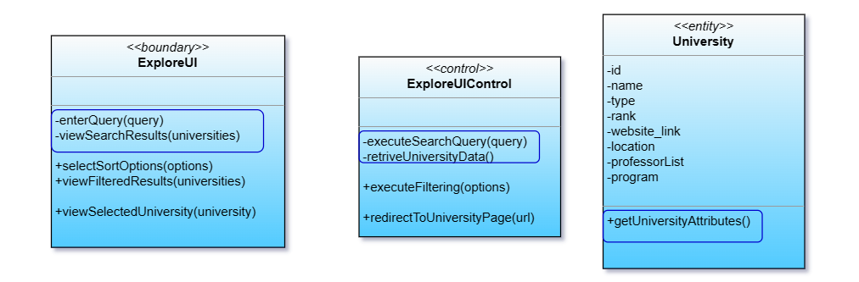
Explore Universities

Slide 4
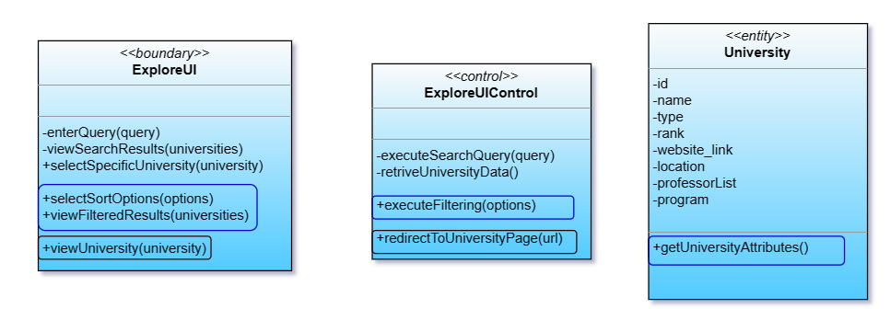
Explore Universities

Slide 5
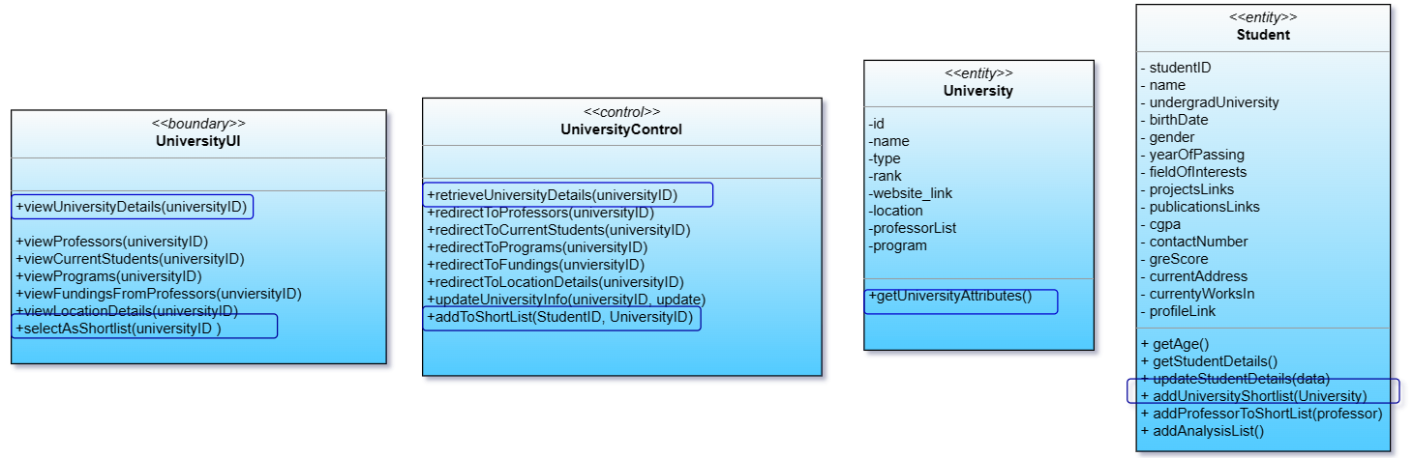
University

Slide 6
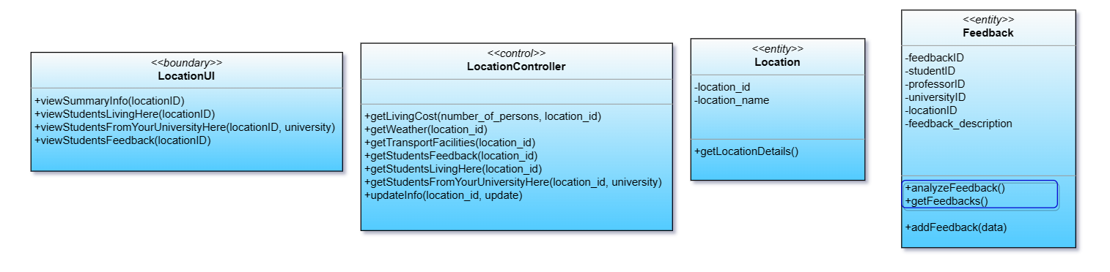
University : Location

Slide 7
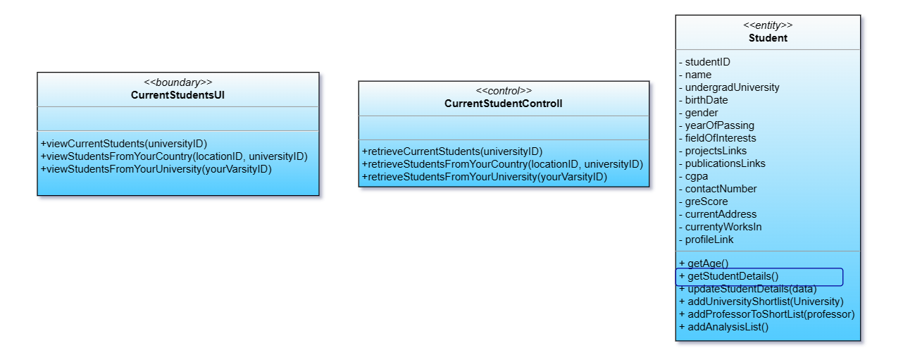
University : Current Student List

Slide 8
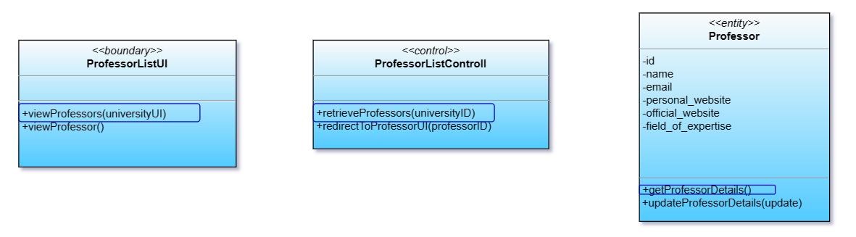
University : Professor List

Slide 9
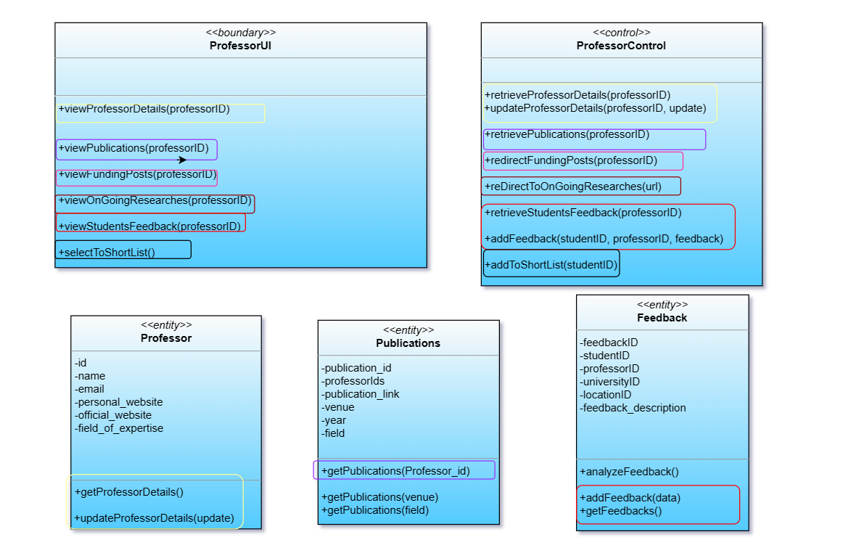
Professor List : Professor

Slide 10
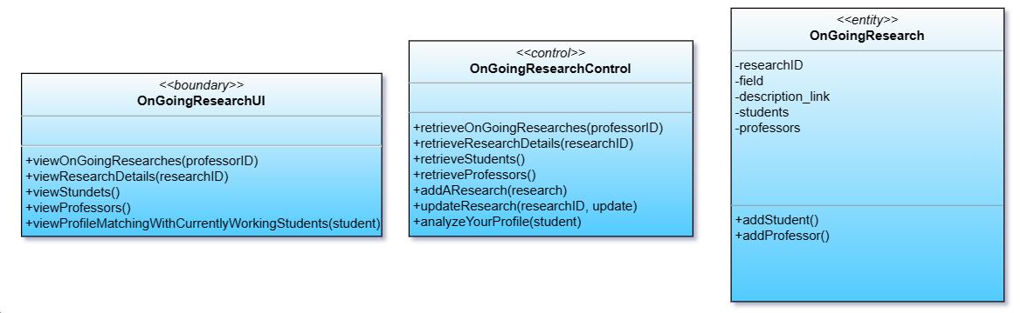
Professor : Ongoing Research

Slide 11
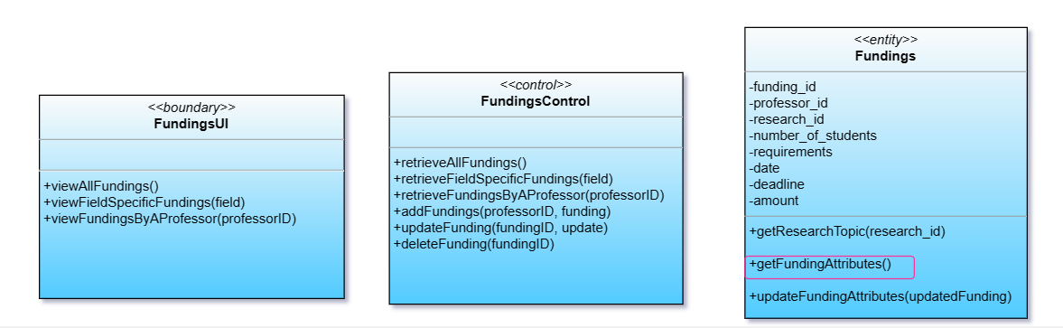
Professor : Fundings

Slide 12
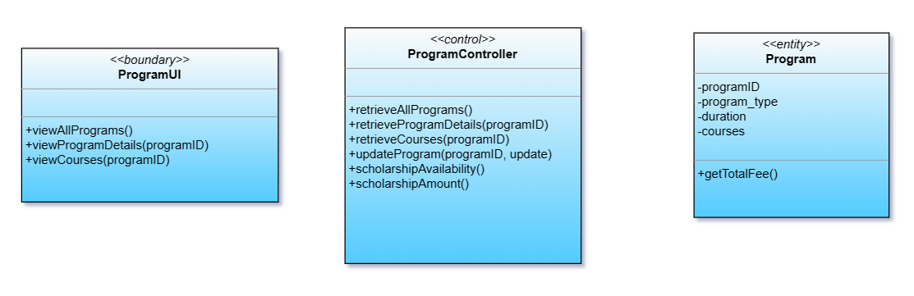
University : Program

Slide 13
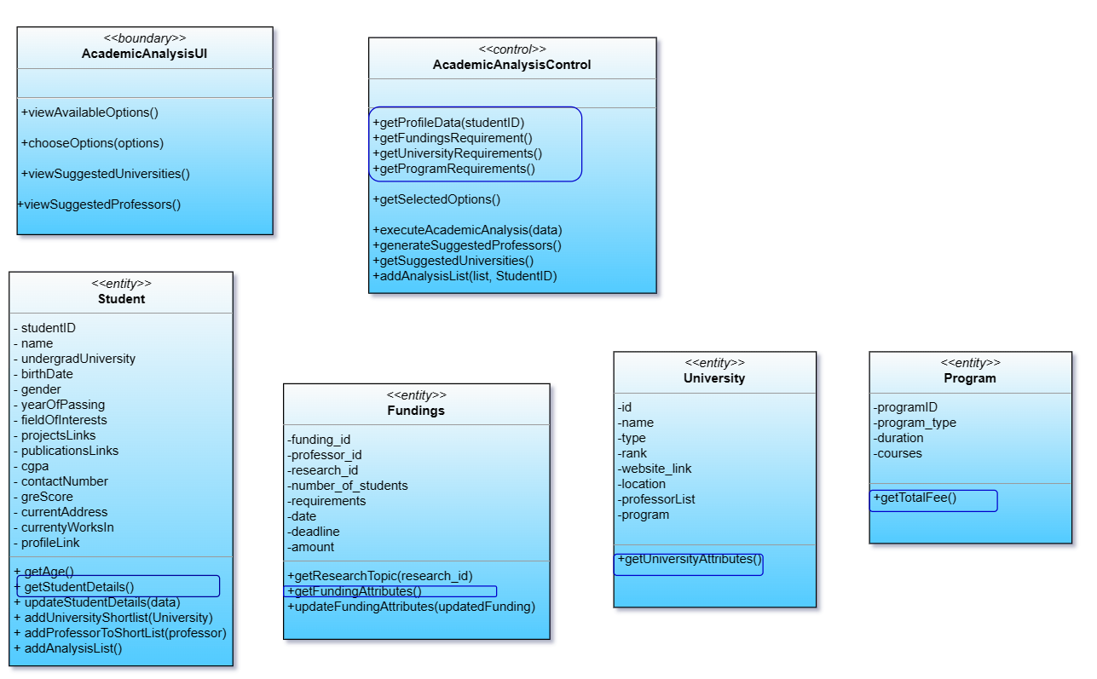
Academic Analysis

Slide 14
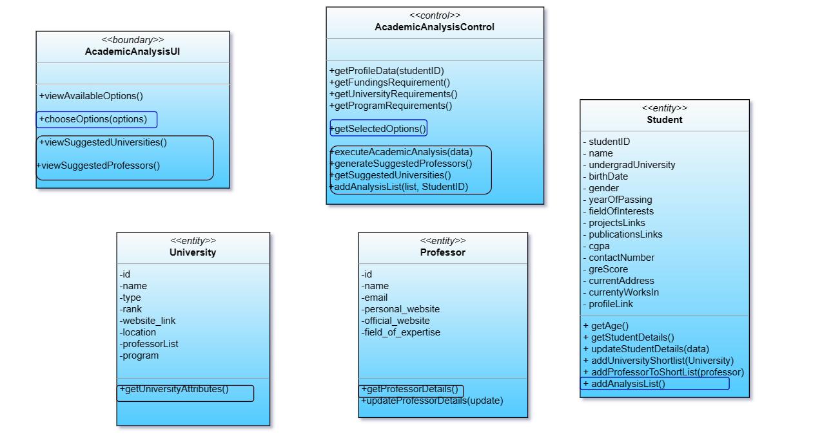
Academic Analysis(cont.)

Slide 15
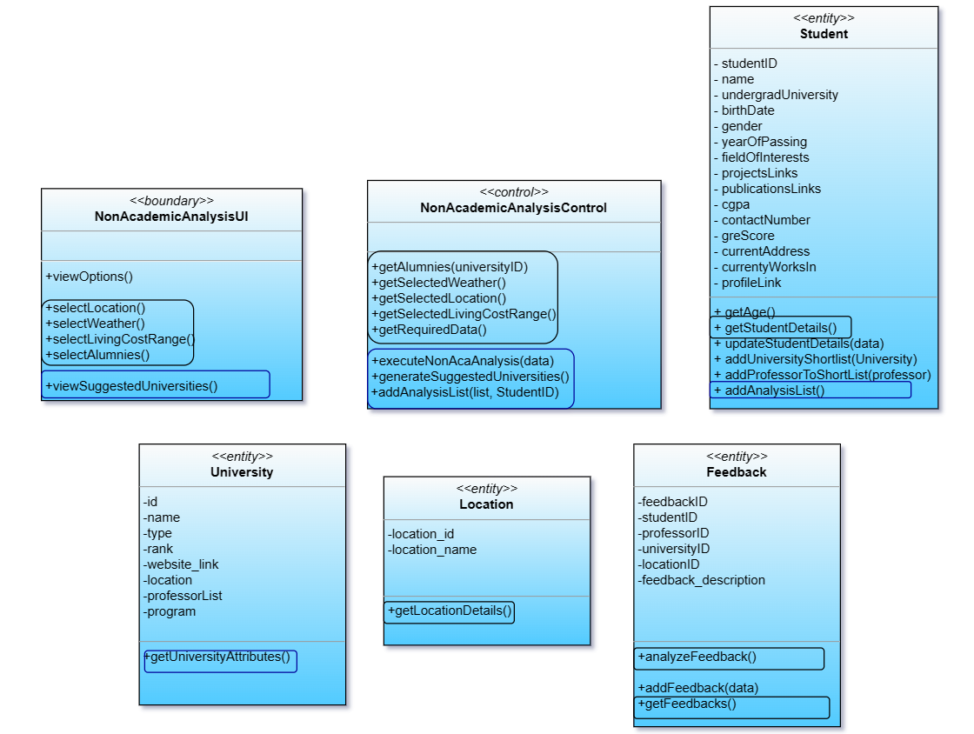
Non Academic Analysis

Slide 16
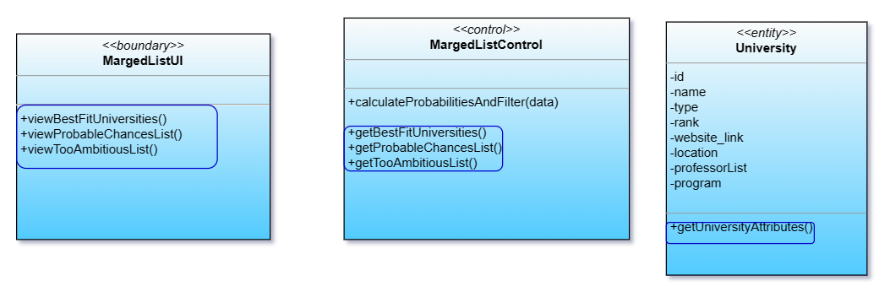
Merged University List

Slide 17
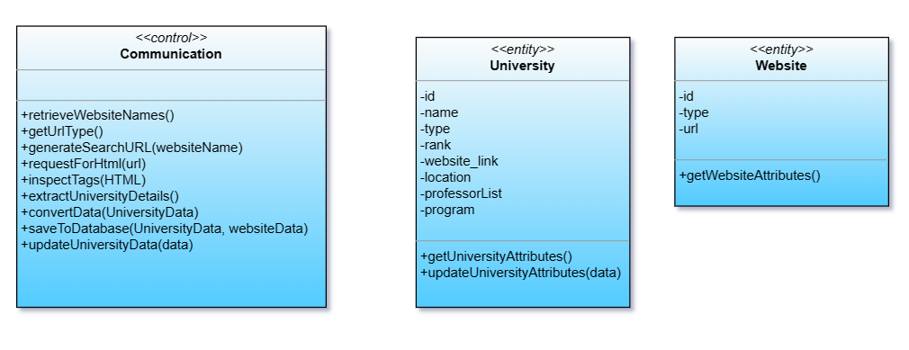
Communicate

Slide 18
THANK YOU
Group Members:
1805092
1805110
1805112
1805113
1805115
1805116

